Slide 1
Acorns Class : Meet the Teacher

Slide 2
Timetable
 | 8:45 – 9:00 | 9:00 – 10:00 | 10 – 10:15 | 10:15– 11:40 | 10:40 11:40 | 11:35 12:00 | 12-1 | 1:00 – 1:30 | 1:30 – 2:30 |  |  | 2:30 to 3:15
Monday | EMA | English | Break | Phonics | Maths | Worship | Lunch | Book Talk | Geog or History |  |  | Year 2 – Dedicated time for Year 2 content in Maths / English Year 1 and EYFS – Dedicated time for child led provision
Tuesday | EMA | English | Break | Phonics | Maths | Worship | Lunch | Book talk | Swimming ( T1-3)
Wednesday | EMA | English | Break | Phonics | Maths | Spelling and Grammar | Lunch | Worship |  |  | Book Talk |  | Art /DT |  | Story
Thursday | EMA | English | Break | Phonics | Maths | Worship | Lunch | PE |  |  |  | Computing
Friday | EMA | PE | Break | RE / Music |  | Worship | Lunch | Book Talk/ EYFS phonics |  | Science |  |  | Handwriting / PSHE | Handwriting / PSHE
PHSE : Personal, Social and Emotional Education EMA : Early Morning Activities

Slide 3
Who is who ?
Mrs Spring is the class teacher. On Wednesday afternoons the class is taken by Mrs Russelland on Friday mornings the class is taken by our PE coach and Mrs Davies. Mrs Russell teaches Acorn Class for for Art or DT. This allows Mrs Spring time to complete her senior leader duties at Bibury and North Cerney schools.
Miss Bevans teaches the Year 3/4 class
Mrs Davies teaches the Year 5/6 class
Mrs Williams works with Acorns Class all week and she works with the EYFS group alongside Mrs Spring
Mrs Lincoln runs the office and messages can be left with her by phone or email
Mrs Feltham support groups of children for Maths within the lesson and also supports with some interventions and hearing readers
Mrs Howe helps with lunches and hears readers

Slide 4
Equipping for the weather and for school activities
Your child will need a bag containing PE kit on Thursday and Fridays. The PE kit can be left in school during the week if needed. Once swimming starts in Term 1 ( newsletter will give details) your child will need swimming kit, towel and goggles on Tuesdays.
Please ensure that your child has a warm coat and appropriate school shoes. Where possible we will be learning and playing outside whatever the weather. If your child is in EYFS and has a spare pair of wellies, these can be left at school.
Please ensure that you label all school clothes with your child’s name. We can waste valuable learning time trying to return unnamed clothing.
Please ensure that your child has a water bottle filled with water every day, these can be refilled with water at our drinks dispenser.
Children in Acorns Class are offered a healthy snack every morning playtime and so there is no need to supply these yourself. If your child does not like fruit then a cheese snack or similar healthy snack can be substituted from home. We ask that no plastic packaging is brought into school – a tupperware container for snacks is better for our environment.
We are a No Nuts school.
The PTA welcome donations of second hand uniform. Please inform us if you are having difficulty equipping your child with school uniform.

Slide 5
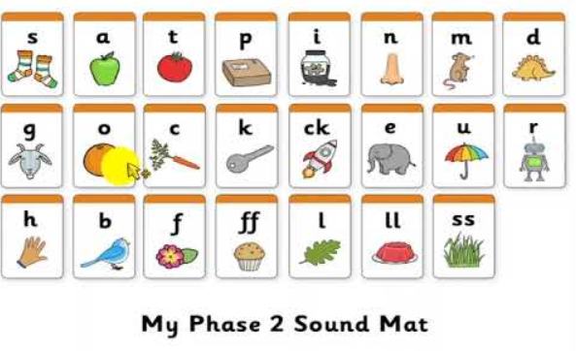
What is phonics ?
Phonics is the name for letters and the sounds they make.
In Acorns Class phonics is taught daily as a dedicated lesson,. We follow the Essential Letters and Sounds scheme which has been validated by the Department of Education.
Year 1 will have a Phonics Screening Test in June next year. We informally assess each child in EYFS and Y1 every fortnight to ensure no child is left behind in acquiring these key skills.
EYFS Autumn Term 1 | Phase 2 phonics ( individual sounds)
EYFS Autumn Term 2 | Phase 3 phonics ( 2 and 3 letter sounds)
EYFS Spring Term 1 and 2 | Consolidation and recap
EYFS Summer Term | Phase 4 phonics ( consonant cluster sounds) and introduce Phase 5 sounds
Year 1 | Phase 5 sounds ( more 2 and 3 letter sounds ) in addition to spelling rules for prefixes and suffixes
Year 2 | Recap of Phase 5 sounds where needed followed by Phase 6 ( spelling rules )

Slide 6
Reading
Children begin by learning the sounds for S A T P I N beginning in Week 1. They will then practise blending these sounds to read simple words eg. i-t or p-i-n
When children can blend sounds together independently they are ready to begin reading books.
Children are given carefully chosen books to match the phonic sounds they know. Children will bring home a fully phonetically decodable book to read at home. These books contain sounds that your child knows securely making the reading process more enjoyable for them. Your child may also bring home another book which will contain words they can not read for themselves yet – please read these books to your child and enjoy talking about them.
Children in Year 2 who can confidently read Phase 6 phonics books will move onto the Accelerated Reader scheme as free readers with access to the school library. After each book, they take a quiz in school to develop their reading comprehension skills.
Children have a reading record book. One side of the page is for school staff to fill in ( we aim to hear all KS1 read once a day if possible). The other side is for you to complete at home ( daily).

Slide 7
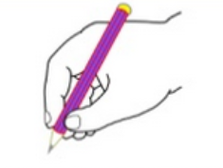
Writing
The tripod grip
Writing begins with gross motor skills and fine motor skills – the ability to sit at a desk holding your torso straight, the ability to hold a pencil comfortably and the ability to make vertical, horizontal and circular marks with their pencil using a tripod grip.
Children are taught how to form letters as they learn the phonic sounds and handwriting skills are further developed in year 1 and year 2 to assist with joining their letters neatly.
Writing lessons focus on rehearsing and then writing clear sentences using increasingly sophisticated vocabulary. Children are then taught how to sustain this writing and build up stamina to write longer pieces of writing and stories. Children in Year 1 and Year 2 are taught how to edit their work for spelling errors, punctuation and improved word choices. We follow an approach called The Write Stuff by Jane Considine which is producing stunning writing !
This is a link to a useful website about pencil grip development https://www.the-elbowroom.com/useful-information/news/stages-of-pencil-grasp-development/

Slide 8
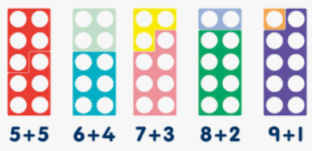
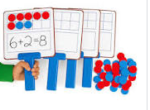
Maths
Maths lessons in EYFS are largely practical in nature in order to develop the children’s understanding of number, shape and measure.
Children in Year 1 and Year 2 have 2 maths sessions daily– a shorter maths skills lesson which teaches basic counting, calculation, number bonds and times tables. These are the building blocks for maths problem solving. They also have a longer maths lesson where problem solving and reasoning skills are taught and applied.
Throughout the school children use physical resources to support their maths understanding; children are taught to understand how calculation methods work rather than learning a ‘trick’
Each year group has a number of key skills to be mastered. We have split these up into termly lists and children will need to practise these weekly as their maths homework. These lists are referred to as KIRFS ( Key Instant Recall Facts)

Slide 9
Homework
Listening to your child read their book for 10 minutes ( 15 mins for Year 2 ) a day is a must to ensure progress . If your child is young and is tiring, try you read a page, they read a page. Please record all your reading in the red reading record book on the home side of the page. We will complete the school side of the page as we hear them read.
Continue to read a bedtime story to your child – this is so important because it exposes them to language and context that they can not read for themselves. Throughout the school children enjoy the end of day story and often say this is their favourite part of their day – make it your family tradition if it is not already.
Homework will focus on reading and learning their KIRFS (mathematical mental recall facts). If your child is very tired please prioritise reading over everything else.
All children have activities set on Mathletics each term. Please spend some time completing these over the term, one or two activities weekly is best. Children will need adult help at least to begin with for these tasks until their independent reading becomes more fluent.

Slide 10
Celebrating Success
Every week we have a Celebration Worship where selected children are awarded the Star of the Week certificate. This might be for academic achievement, good progress, perseverance, a WOW moment or going above and beyond to help another child.
Every week we have certificates given out to reward work completed online using Mathletics. We also give out awards from Accelerated Reader to children who achieve their termly reading target.. Acorns will also receive awards for moving up a Book Level this year.
When we spot one of our Christian values being enacted children are awarded with a special certificate to recognise when they have been kind, courageous, respectful, curious etc
Each term we hand out two awards per class. One is a Worm of the Term – this is awarded for reading. The award may be given for the child with the best reading progress, the most time spent at home reading etc. Our other award is for maths with a Times Table Champion for Oaks and Mighty Oaks and a Number Bond Champion for Acorns. Please ensure you help your child learn their tables and number bonds – daily practise is the key.
Every so often we give out our most special award – The Socks Off Award. This award is given to a child when we have seen them consistently working their socks off . In school this would look like always trying their best in all lessons, persevering when things get hard, being a role model for the school consistently. We also require children to demonstrate that they are working hard at home, completing all homework, reading daily, practising their KIRFS in maths etc. The children receive a pair of special socks, a certificate and the biggest round of applause of them all !

Slide 11
How can I find out more about the EYFS curriculum ?
There are 17 areas of learning for EYFS each with their own Early Learning Goals. At the end of the year each child is assessed as having Emerging skills in these areas or having achieved the Expected level of skill in these areas. We will keep you informed of your child’s progress at two parents evenings and several reports across the year. We can also have informal discussions at pick up time, if needed.
In order to keep you informed about the demands of the curriculum, we have added a factsheet about each of the areas of learning on our website. Each factsheet contains the statutory Early Learning Goals we must assess against but also a selection of other objectives taken from the broader EYFS curriculum. The fact sheets also contain some suggested books to help your child or provide more details about how to support your child .Copies of all the information sheets can be viewed on the school website under EYFS curriculum information.

Slide 12
Contacting your teacher
Talking through worries and concerns is important. Please do not hesitate to ask, the earlier we know about a concern, the easier it is to resolve.
Mrs Spring is available at pick up times after school on the days that she is teaching. If the matter is urgent and she is not available, please leave a message with the office or with another member of staff. If you have an urgent message in the morning please email the admin account admin@bibury.gloucs.sch.uk or leave a message with the member of staff on duty in the back playground. Teachers are generally unavailable at the start of the day as they are busy setting up learning for your child.
If you are unexpectedly delayed picking up your child, please telephone the school and your child can have a place in our after school club until you arrive. After school club runs from 3:15 to 4:15 daily.

